Slide 1
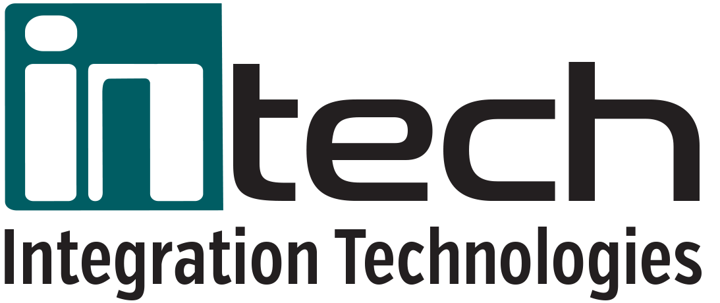
Safeguarding Your Data with Intech Recovery Services

Slide 2
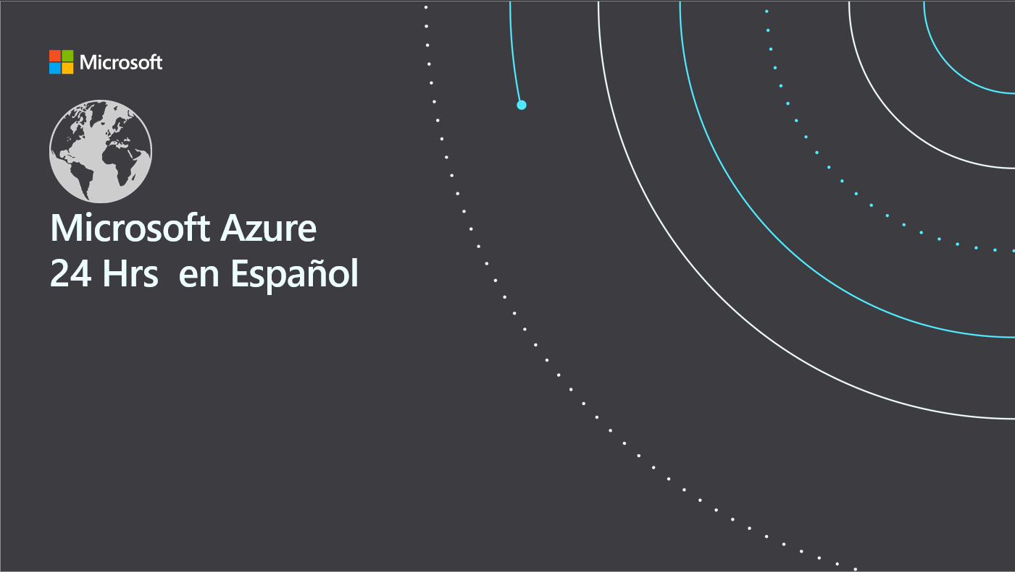
Disaster Recovery de 0 a 100 de forma fácil
Isaias Martinez
Cloud Architect
isaias.martinez@intechxsp.com

Slide 3
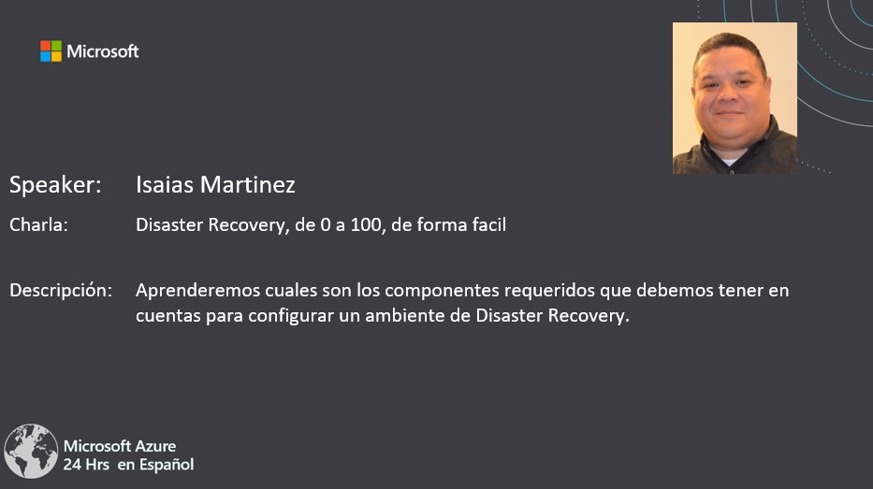

Slide 4
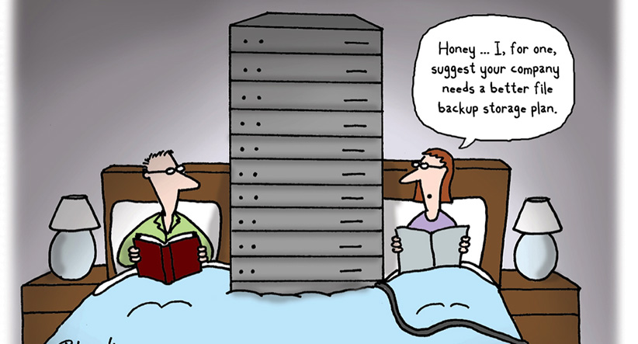

Slide 5
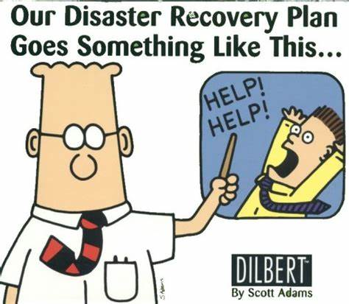

Slide 6
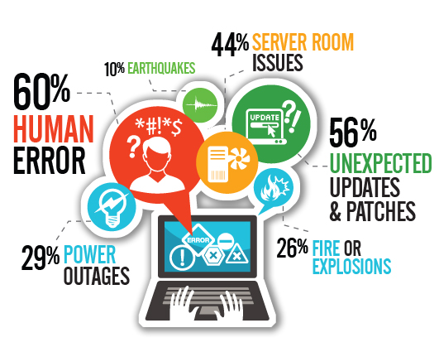

Slide 7
Contents
Impacts of disruptions on business continuity
Challenges of managing an on-premises disaster recovery solution
Addressing disaster recovery challenges
Summary/next steps

Slide 8
Impacts of disruptions on your business
Studies show organizations experience up to four disruptions/year
Costs are staggering:
up to $1.5 million per hour
Bigger, longer-lasting impacts if production, compliance are affected

Slide 9
We can help safeguard your data and applications
Azure-based disaster recovery solution minimizes disruption impacts
Recovery within minutes, with
near-zero data loss
We handle disaster recovery complexity, so you can focus on other priorities
Solution supports heterogeneous/ hybrid hosted IT environments

Slide 10
How our solution addresses disaster recovery challenges
Ensuring business continuity
Our hosted, Azure-based solution minimizes impacts of disruptions and gets you back in business in minutes, with near-zero data loss.
Managing complexity
Let our experts handle disaster recovery complexity, so your employees can focus on high-impact activities.
Reliable solution
Our solution is based on rigorously tested Azure Site Recovery. ASR is used by organizations worldwide to protect their business-critical data and apps.
Managing large datasets
Our solution is built from the ground up to safeguard high-volume data.
Staying in compliance
Test without affecting production workloads, and be confident you’re meeting compliance objectives.

Slide 11
Business continuity challenges
Impact of data growth on business continuity
Business continuity
Roadblock
Complexity of protecting data and applications
Too much data—often with insufficient protection
Long data-retention requirements
Time-intensive media management
Untested disaster recovery and decreasing recovery confidence
Higher costs as data size and number of virtual machines increase
Notes:
Slide Goal: Review and establish the business continuity challenges organizations face.
IT teams have many challenges maintaining their business continuity capabilities. High data growth rates create numerous problems including the complex process of load balancing workloads between storage systems that are running out of capacity ─ a scenario that can lead to downtime if not corrected soon enough ─ but can also impact business continuity by impacting application performance.
Business continuity is plagued by complicated processes, complex change control, and human errors. They’re challenging to establish, and even more challenging to maintain.
Extremely rapid data growth – often 40% annually – means the cost of protecting that data is growing at the same rate. Many organizations only protect their most critical data well, while leaving “tier 2” and “tier 3” workloads with little – or even NO – protection.
Some organizations are bound by regulations to maintain data for years. But even those that don’t often wish to retain their data longer, but lack the disk capacity to do so. Length of retention multiplied by fast-growing data sizes means this is another big cost area.
Some use tape, which requires more time to manage properly – and often involves both onsite and offsite media management.
Due to the complexity involved, many organizations fail to test recoveries of any but their most recent backups. And many don’t test their DR plans regularly to ensure they’re up to date and result in rapid restoration of service.
Most of the costs around data protection and disaster recovery grow linearly with the growth of data and number of applications/VMs
Organizations wanting to expand and improve their business continuity capabilities to cover additional data and applications often find they don’t have the means to do it with the solutions they have.
The bottom line is that overall confidence in their recovery abilities is low and getting lower each year as the amount of data and the cost of data protection increases.

Slide 12
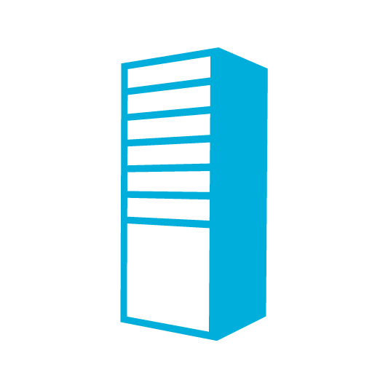




Business continuity challenges
Bypassing the obstacles
Roadblock
Business continuity
Roadblock
Automate, automate, automate
Protecting data and applications is complex
Integrate solutions which scale with data and VMs
Too much data—often with insufficient protection
Increase breadth and depth of protection
Long data retention requirements
Eliminate media management
Time-intensive media management
Implement testable solutions
Untested DR and decreasing recovery confidence
Achieve cost and operations stability
Costs scale with data size and number of VMs
Notes:
So how do IT teams get beyond these obstacles to improved business continuity protection? Here are the game-changers they need:
First, they need to automate as many business continuity solutions and processes as they can. Removing human errors from repetitive tasks makes business continuity more reliable as well as speeding the effort. Automation brings new levels of efficiency that are needed to deal with data growth problems.
Along with automation, they need better integration of primary data storage with secondary storage used for data protection – especially the automation and integration of offsite storage.
Most organizations would be well served by increasing the breadth and depth of their data and application protection to cover those tier 2 workloads – for which costs are only truly understood after an outage.
Eliminating media management reduces complexity significantly.
The ability to test data protection and DR solutions is a key capability which should be assessed before selecting a solution. You need to be able to test data restores and application failovers frequently, on your own time table. And you need the confidence that applications will fail back correctly after the primary datacenter has been restored. Many IT teams do not like to admit that it has been far too long since they have tested their recovery capabilities, and they fear what would happen if they had to recover from a large-scale disaster. New solutions for business continuity need to make it easier for IT teams to test their capabilities and find out what works and what needs improving.
And you want to ensure your business continuity at a reasonable cost.

Slide 13
Protection that evolves with your IT
IT solutions are not silos—your business continuity solutions shouldn’t be
Physical
Virtual
Hybrid cloud
Cloud
On-premises—built and managed infrastructure
Cloud—flexible, remote infrastructure
Microsoft provides solutions across all four scenarios
Notes:
Slide Goal: Set the context that Microsoft solutions cover the spectrum of customer environments, protecting them “where they live” – and evolving with them over time. We have the breadth to cover their various environments today.
Just about everyone has some physical infrastructure and some virtual infrastructure today. As you evolve this infrastructure into private clouds or hybrid clouds, or move entire workloads to the public cloud, you need business continuity solutions that cover the entire breadth of your IT environment. Microsoft provides this protection today – so whatever your infrastructure looks like today, you can deploy solutions. And whether your position on moving to the cloud is “never” or “moving this afternoon,” Microsoft can help protect you during the transition of whatever pieces you choose to move, at your own pace.
Where is your company in its journey to cloud adoption? If any! What’s your vision and timeline? What products do you use today? What stands in your way of achieving your vision.?
You may use multiple products for backup, replication and DR – perhaps even different products for differing infrastructure. Or you may have an integrated solution for physical and virtual solutions - but does it support cloud or offer DRaaS.
Our solutions provide the capability to support your current and future needs, including our cloud support, helping power an end-to-end vision, with less complexity. Regardless of what stage you’re at today, a move to the next stage will require you team take on new challenges/problems – BC/DR just one of many. We reduce that problem set by having BC/DR be one less solution on the list to learn and manage. Since we connect all stages together with the capabilities of ASR, we address planned infrastructure as well as their former, which gives us a unique position in the market.
(So whether you simply have a diverse infrastructure you’re looking to protect today, or anticipate a journey to the cloud, our breadth of solution has you covered.)

Slide 14
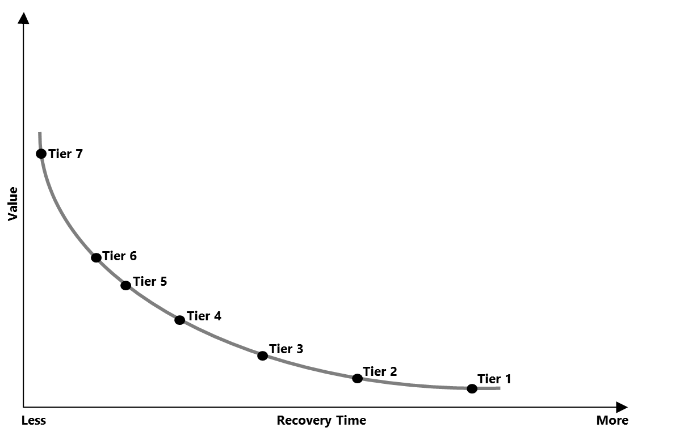
Safeguard your applications
Intech Recovery Service: One solution for multiple infrastructures
  SHARE Standards Group –
  7 tiers of disaster recovery
  Tier 0 – No offsite disaster-recovery plan
  Tier 1 – Data backup with no hot site
  Tier 2 – Data backup with hot site
  Tier 3 – Electronic vaulting
  Tier 4 – Point-in-time copies
  Tier 5 – Transaction integrity
  Tier 6 – Zero or near-zero data loss
  Tier 7 – Highly automated, business-integrated solution
  Azure Site Recovery
Protect your data, your applications, or both—at your site, a hoster’s site, or in Microsoft Azure.
Notes:
Slide goal: Position ASR as a best in class offering.
Azure Site Recovery is a best in class solution, providing highly automated disaster recovery with near zero data loss. With continuous data protection coupled with key features like application consistency, recovery ordering , automated failovers and recovery plans - ASR offers first rate protection, even across heterogeneous environments. Since ASR can provide near zero data loss and can be classified as a highly automated business-integrated solution, it is considered a Tier 7 solution in the 7 tiers of Disaster Recovery, a standard defined by SHARE.
Background on the SHARE model: The Seven Tiers of Disaster Recovery was originally defined by SHARE to help identify the various methods of recovering mission-critical computer systems as required to support business continuity. Although the original known published concept dates back to the 1990s, Business Continuity Planning (BCP) and Disaster Recovery specialists today continue to use the 7 Tiers to illustrate continuity capabilities and costs at a very high level. The definitions for the various Tiers have been updated as technology has evolved in support of today's business requirements and their associated Recovery Time Objective (RTO) and Recovery Point Objective (RPO).
Tier 0: No off-site data – Possibly no recovery
Businesses with a Tier 0 business continuity solution have no business continuity plan. There is no saved information, no documentation, no backup hardware, and no contingency plan. The time necessary to recover in this instance is unpredictable. In fact, it may not be possible to recover at all.
Tier 1: Data backup with no hot site
Businesses that use Tier 1 continuity solutions back up their data and send these backups to an off-site storage facility. The method of transporting these backups is often referred to as "PTAM" - the "Pick-up Truck Access Method." Depending on how often backups are created and shipped, these organizations must be prepared to accept several days to weeks of data loss, but their backups are secure off-site. However, this tier lacks the systems on which to restore data.
Tier 2: Data backup with a hot site
Businesses using Tier 2 business continuity solutions make regular backups on tape. This is combined with an off-site facility and infrastructure (known as a hot site) in which to restore systems from those tapes in the event of a disaster. This solution will still result in the need to recreate several hours or even days' worth of data, but the recovery time is more predictable.
Tier 3: Electronic vaulting
Tier 3 solutions build on the components of Tier 2. Additionally, some mission critical data is electronically vaulted. This electronically vaulted data is typically more current than that which is shipped via PTAM. As a result there is less data recreation or loss after a disaster occurs. The facilities for providing Electronic Remote Vaulting consists of high-speed communication circuits, some form of channel extension equipment and either physical or a virtual tape library and an automated tape library at the remote site. IBM's Peer-to-Peer VTS and Oracle StorageTek Virtual Storage Manager (VSM) Clustering are two examples of this type implementation.
Tier 4: Point-in-time copies
Tier 4 solutions are used by businesses that require both greater data currency and faster recovery than users of lower tiers. Rather than relying largely on shipping tape, as is common on the lower tiers, Tier 4 solutions begin to incorporate more disk based solutions. Several hours of data loss is still possible, but it is easier to make such point-in-time (PiT) copies with greater frequency than tape backups even when electronically vaulted.
Tier 5: Transaction integrity
Tier 5 solutions are used by businesses with a requirement for consistency of data between the production and recovery data centers. There is little to no data loss in such solutions; however, the presence of this functionality is entirely dependent on the application in use.
Tier 6: Zero or near-zero data loss
Tier 6 business continuity solutions maintain the highest levels of data currency. They are used by businesses with little or no tolerance for data loss and who need to restore data to applications rapidly. These solutions have no dependence on the applications or applications staffs to provide data consistency. Tier 6 solutions often require some form of Disk mirroring. There are various synchronous and asynchronous solutions available from the mainframe storage vendors. Each solution is somewhat different, offering different capabilities and providing different Recovery Point and Recovery Time objectives. Often some form of automated tape solution is also required. However, this can vary somewhat depending on the amount and type of data residing on tape.
Tier 7: Highly automated, business integrated solution
Tier 7 solutions include all the major components being used for a Tier 6 solution with the additional integration of automation. This allows a Tier 7 solution to ensure consistency of data above that which is granted by Tier 6 solutions. Additionally, recovery of the applications is automated, allowing for restoration of systems and applications much faster and more reliably than would be possible through manual business continuity procedures.
Azure Site Recovery can offer the lowest levels of recovery time, and the highest value for customers, and when combined with the other components within the Microsoft solutions, helps customers to protect all of their mission critical applications and data.
<next slide>

Slide 15

Safeguard your applications
On-premises to Microsoft Azure protection Intech Recovery Service
Microsoft Azure
Site Recovery
Microsoft Azure
Site Recovery
Orchestration
and replication
Orchestration
and replication
ASR Agent
Primary site
Windows Server
Primary site
VMware/Physical
Key features include:
Use Azure as your disaster recovery site
Automated VM protection and replication
Remote health monitoring
Customizable recovery plans
No-impact recovery plan testing
Orchestrated recovery of tiered applications
Support for heterogeneous environments
Notes:
Slide Goal: Emphasize the “to Azure” element of the solution
Slide Notes:
Azure Site Recovery also provides the capability to replicate virtual machines to Azure, which means you can avoid the complexity and costs of establishing and maintaining a secondary site of your own. Today you can do this with Hyper-V virtual machines. InMage Scout software capabilities will be integrated and expanded over time to provide this capability for physical servers and VMware virtual machines in 2015.
The basic capabilities remain almost identical whether you choose to replicate to your own secondary site or to Azure. (You cannot run custom PowerShell scripts in Azure, as you can at your own secondary site, but we do provide integration with Azure Automation.)

Slide 16
Intech Recovery Service Use Cases
Disaster Recovery
  Compliance Assurance without impacting Production
  Disaster Avoidance – Hurricane warning
  Failover during real disasters – Fire, Earthquake etc.
Migration
  No impact on production during replication – Just minutes of downtime during cutover
  Test before migration using Test failover
  Free Migration
Dev/Test environment
  Using Test Failover get an identical copy of your production environment
  Use this for testing different scenarios like Patch Tuesday, New release testing
  Deploy new patches/bits to production with confidence.

Slide 17

Azure Site Recovery
One solution for multiple infrastructures
Replication
Replication
Microsoft
Azure
Microsoft
Azure
Hyper-V
VMware
1
Hyper-V to Microsoft Azure
2
VMware to Microsoft Azure
Replication
Replication
Microsoft
Azure
Microsoft
Azure
Physical
Any Cloud
3
Physical to Microsoft Azure
4
Any Cloud to Microsoft Azure
Protect important applications by coordinating the replication and recovery of private clouds across sites.
Protect your applications to your own second site, a hoster’s site, or even use Microsoft Azure as your disaster recovery site.
Notes:
So that brings us back to these 5 core focus areas. Hopefully now, after spending time learning about each of these core areas, you can see how Azure Site Recovery provides incredible value, rich capabilities and flexibility to meet your business continuity needs.
<next slide>

Slide 18
Value proposition
Heterogeneous replication: protection for physical and virtual environments, regardless of underlying hardware.
Near-zero RPO: lightweight mobility service on the primary servers to track
and replicate data changes continuously in real-time.
N-tier application consistency: guest level app discovery and enforcement of consistency across all VMs in a multi-tier app.
Best-in-class RTO: end-to-end recovery orchestration such as network adaptation
and sequencing to minimize site level RTO.
Low Cost: Per server monthly, in case of a real event, only pay for the time that servers are runing.
Notes:
…but what are some of the key value propositions that InMage brings to Azure Site Recovery? Well firstly, it’s support for heterogeneous environments. As we learnt earlier, ASR supports Microsoft-based environments, and relies on Hyper-V Replica as the replication engine to replicate data between on-premises locations, and between on-premises and Azure. With InMage however, things change considerably. InMage Scout works at the guest level, at the OS level, thus is agnostic of the underlying hardware platform. It could be a physical server, or a VMware virtual machine – either way, Scout handles the replication, and will orchestrate the recovery of workloads from one location, to another.
<click>
Scout also uses a very lightweight mobility service inside the source OS, known as the Data Tap, which tracks and replicates data changes continuously, in real time, sending them off to the local Process Server, which in turn, sends the data to the target site. It’s an extremely efficient process, and through the use of this architecture, means the impact to the workload itself is negligible.
<click>
When replicating workloads, often, there are workloads that rely on one another. A 3 tier application for instance, may rely on all pieces of that application being in ‘sync’ with one another, both on the primary site, and after a failover on the recovery site. Thankfully, InMage Scout provides N-Tier app consistency. Applications can be automatically discovered, and InMage Scout will protect each of the key elements of the tiered application, and guarantees consistency across the tiers upon failover.
<click>
You recovery time objective is a critical piece of your DR story. Fortunately, with InMage Scout, and it’s in-built orchestration capabilities, it’s easy to setup and ensure that your VMs and brought online in the correct sequence, but at the same time, Scout also enables you to adjust certain VM settings for the VMs that come up on the recovery site, for the highest levels of flexibility.
<click>
Finally, InMage Scout joins the ASR family with a wealth of experience, maturity and large scale adoption. With a large number of patented technologies, and support for a large variety of platforms, from Windows to Linux, physical to virtual, InMage Scout and Azure Site Recovery provide an incredible combination to enable you to protect every workload within your environment.
<next slide>

Slide 19
Summary
Summary
Try Windows Server and System Center Technical Preview
Disruptions are common and costly, with far-reaching impacts
Our disaster recovery solutions minimize impacts of disruptions on your organization
Automated monitoring, with fast, reliable recovery
Let us handle disaster recovery complexities―so you can focus on your business

Slide 20


